Slide 1

Staffing Efficiency at Help Desk
Chris Calvo, Drew Barton and jake Pagels

Slide 2
Table of Contents
Problem Statement
Major Findings
Recommendations for Action
The Data
Descriptive Statistics
Exploratory Data Analysis (EDA)
Data Cleansing

Slide 3
Problem Statement
This summary examines average daily call patterns and staffing efficiencies during a representative week

Slide 4


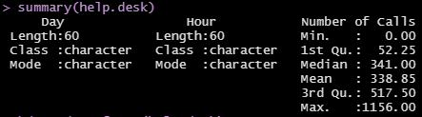
The Data: Help Desk.xlsx
Sample of observations believed to represent typical call traffic at the help desk
Structure: 60 observations of 3 variables
$Day – chr
$Hour – chr
$’Number of Calls’ – num
Summary:
Mean as an int: 339 calls
Median: 341
Range: 1156 calls
Notes:
The Help Desk data table provides information on typical volumes for a week of help desk calls; This sample in particular was pulled from calls recorded in the month of October.
Structure of the data is 60 observations of 3 columns:
‘Day’ & ‘Hour’ vectors have character data type
, ‘Number of Calls’ is a numerical data type
A quick summary of the data shows a total range of observable calls of 1,156, median value of 341, and a mean of 339 calls rounded as an integer

Slide 5
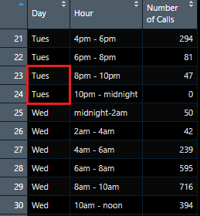
Data Cleansing
Confirmed no missing (NA) values in data set
Data contained negative values in ‘Number of Calls’ column
Recoded values to 0 because it is the lowest observed value and most reasonable
Conflicting values in ‘Day’ column
Recoded “Tue” values to “Tues” for uniformity
Values recoded from “Tue” to “Tues”
One of the negative values in the data set that we recoded to 0
Notes:
Similar to the groups that have already presented: by looking at the data table comprehensively, we quickly noticed a few outliers and values that we determined as erroneous inputs
In order to provide accurate predictions to management based upon the data, we determined that a data cleansing task would solve the data integrity issues.
We first determined there were no missing (NA) values in the data as this could skew our numbers
We then noticed that the ‘Number of Calls’ column had negative values.
Recoded negative values to 0 -> lowest observed value in the data set.
There were two different values attributed to ‘Tuesday’ – values ‘Tue’ and ‘Tues’.
As only a couple of the values were ‘Tue’ out of the column, we recoded these to ‘Tues’ for uniformity of the data, and our group considered this to be a data input error.
This was actually an extremely important step because similar to say SQL or Pandas: when doing a group by sum or any group by function, the group by will aggregate by the unique or distinct values. If the Tuesday values are not recoded correctly we would get an erroneous output.

Slide 6
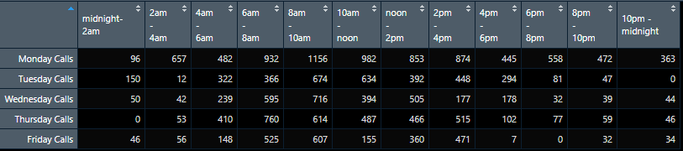
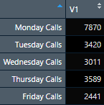
EDA
Converted to dataframe, sliced data, and transposed
In order to analyze and make predictions on the data we first looked at reordering the values
Used dplyr library to sum the ‘Number of Calls’ grouped by ‘Day’
Clearly see Mondays have heaviest volume of calls with 2x the next day which is Thursday
Notes:
When first looking at the data table, we thought that the data was not highly visible as a vertical column.
Hard to spot trends and outliers when your data is in one column spread out in a spreadsheet
By converting the data to a dataframe, it was much easier to manipulate
We sliced the data by the unique ‘Day’ values, added the ‘Hour’ values as columns, and then stacked the calls horizontally, allowing us to easily see all the calls using the head() function
By using the DPLYR library which provides a set of tools for efficiently manipulating datasets, we could sum the volume of calls by day for the week analyzed.
You can clearly see that Monday had the heaviest call volume which is more than twice that of the next heaviest call day, which was Thursday.

Slide 7
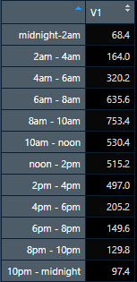
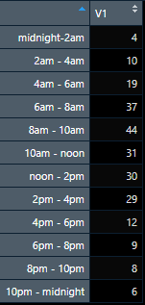
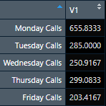
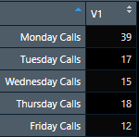
EDA Continued
Chose mean as statistic that will provide best recommendation to management
Calculated and created ‘Mean Calls by Day’ and ‘Mean Calls by Shift’ variables
Divided these variables by 17 (average number of calls/employee/two-hour shift) to derive:
‘Mean Staff by Day’
‘Mean Staff by Shift’
Mean Calls by Shift
Mean Staff by Shift
Mean Calls by Day
Mean Staff by Day
Notes:
Our team decided to use the mean statistic for the data set as the best metric to evaluate the data – rounded to 0 decimals was 339 calls
By using mean you can quickly calculate any day’s variance based on the sample size and staff accordingly
The Mean also allowed us to create quick ‘Mean calls by day’ and ‘Mean calls by shift’ variables in R
From the data assumption provided, we knew the average number of calls/employee/two-hour shift is 17
This allowed us to calculate the ‘Mean Staff Needed by Day’, and the ‘Mean Staff Needed by 2-hour Shift’
You can easily see the trend average of calls by day falls steeply from Monday through the rest of the week.
My calculating Mean staff by shift, we can highlight the peak 2-hr shifts throughout the week which one of my team members will discuss shortly
From here my colleagues will present our group’s Major Findings and Recommendations for Action:
Next Slide

Slide 8
Major Findings
Calls peaked between 8am and 10am on every day except Thursday between 6am and 8am
Highest call volume per shift was 1,156 and occurred on Monday between 8am and 10am
Monday represents the greatest staffing need, with 39% of the observed call volume
Generally, calls tapered after 6pm until early morning the next day
Day of Week | Total Calls | Peak Shift | Non-Peak Shifts
Monday | 7,870 | 8am – 10am | 6pm – 12am
Tuesday | 3,420 | 8am – 10am | 6pm – 12am
Wednesday | 3,011 | 8am – 10am | 6pm – 12am
Thursday | 3,589 | 6am – 8am | 6pm – 12am
Friday | 2,441 | 8am – 10am | 4pm – 12am

Slide 9
Descriptive Statistics
Average numbers of calls per shift is 339 calls with a typical fluctuation of 297 calls
Call range from 1,156 calls to 0 calls per shift
50% of the shifts have calls between 52 calls and 518 calls
Descriptive Statistics
Mean | 339
Median | 341
Mode | 0
1st Q | 52
3rd Q | 518
Interquartile Range | 465
Min | 0
Max | 1,156
Range | 1,156
Standard Deviation | 297

Slide 10
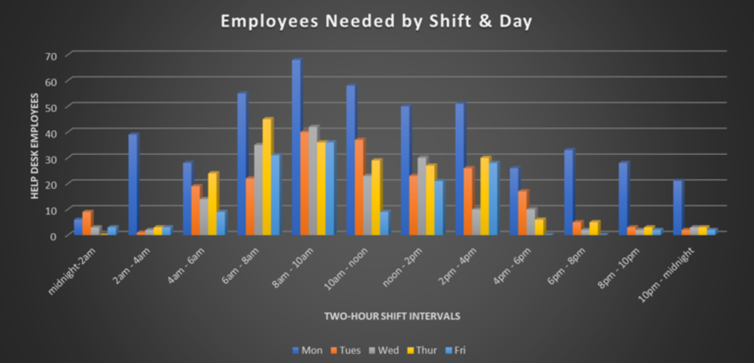
Recommendations for Action
Increase staffing on peak shifts, specifically on Mondays
Reduce staffing on non-peak shifts, specifically on shifts between 6pm and 12am

Slide 11
Thank You

